Slide 1
Why Layer-3 IXPs Don’t Make Sense
Hisham Ibrahim
AFIX meeting
AFPIF 2018

Slide 2
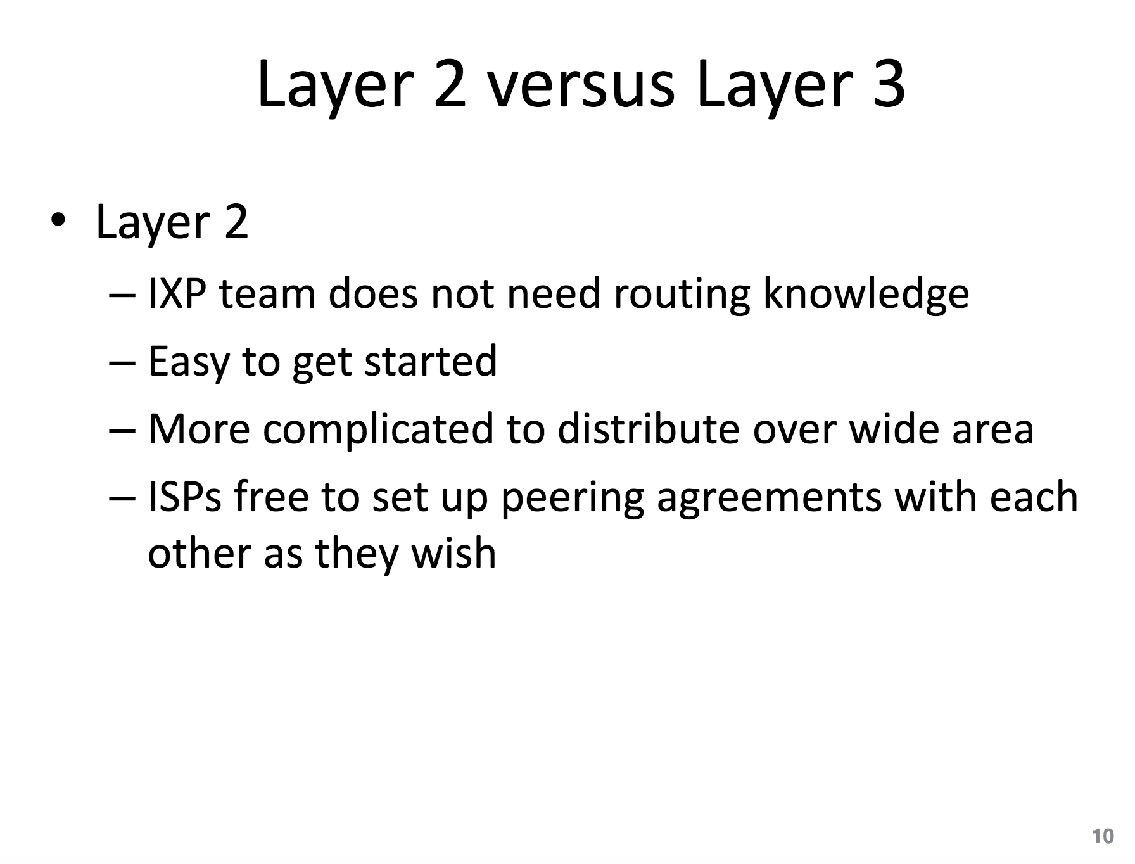
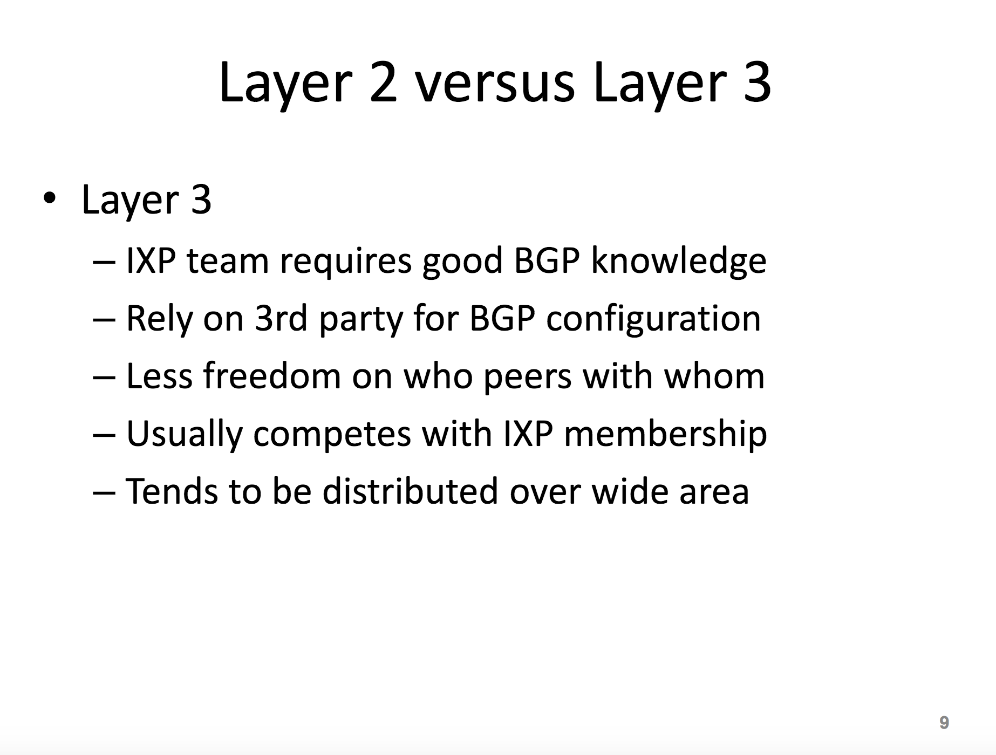

Slide 3
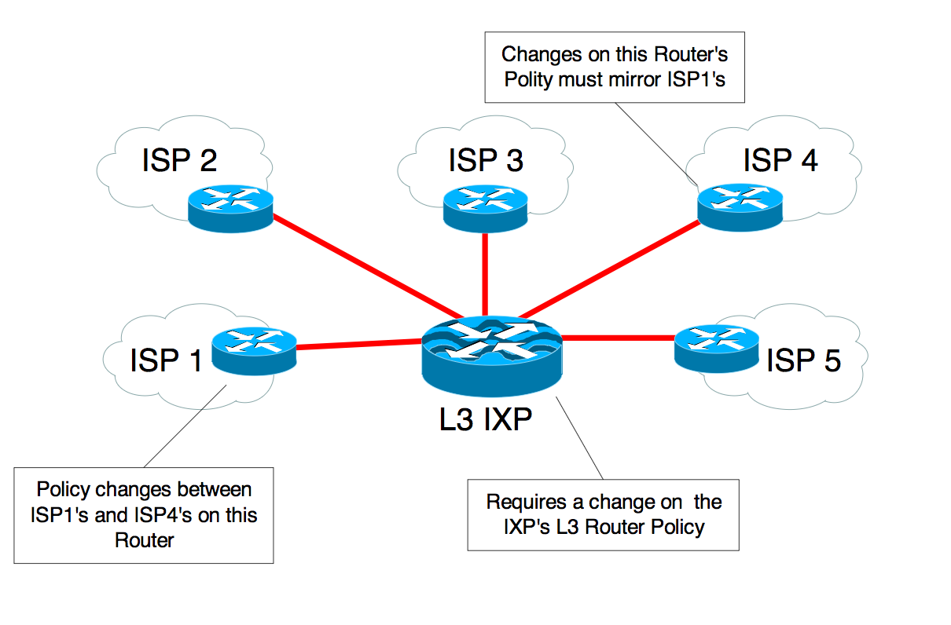

Slide 4
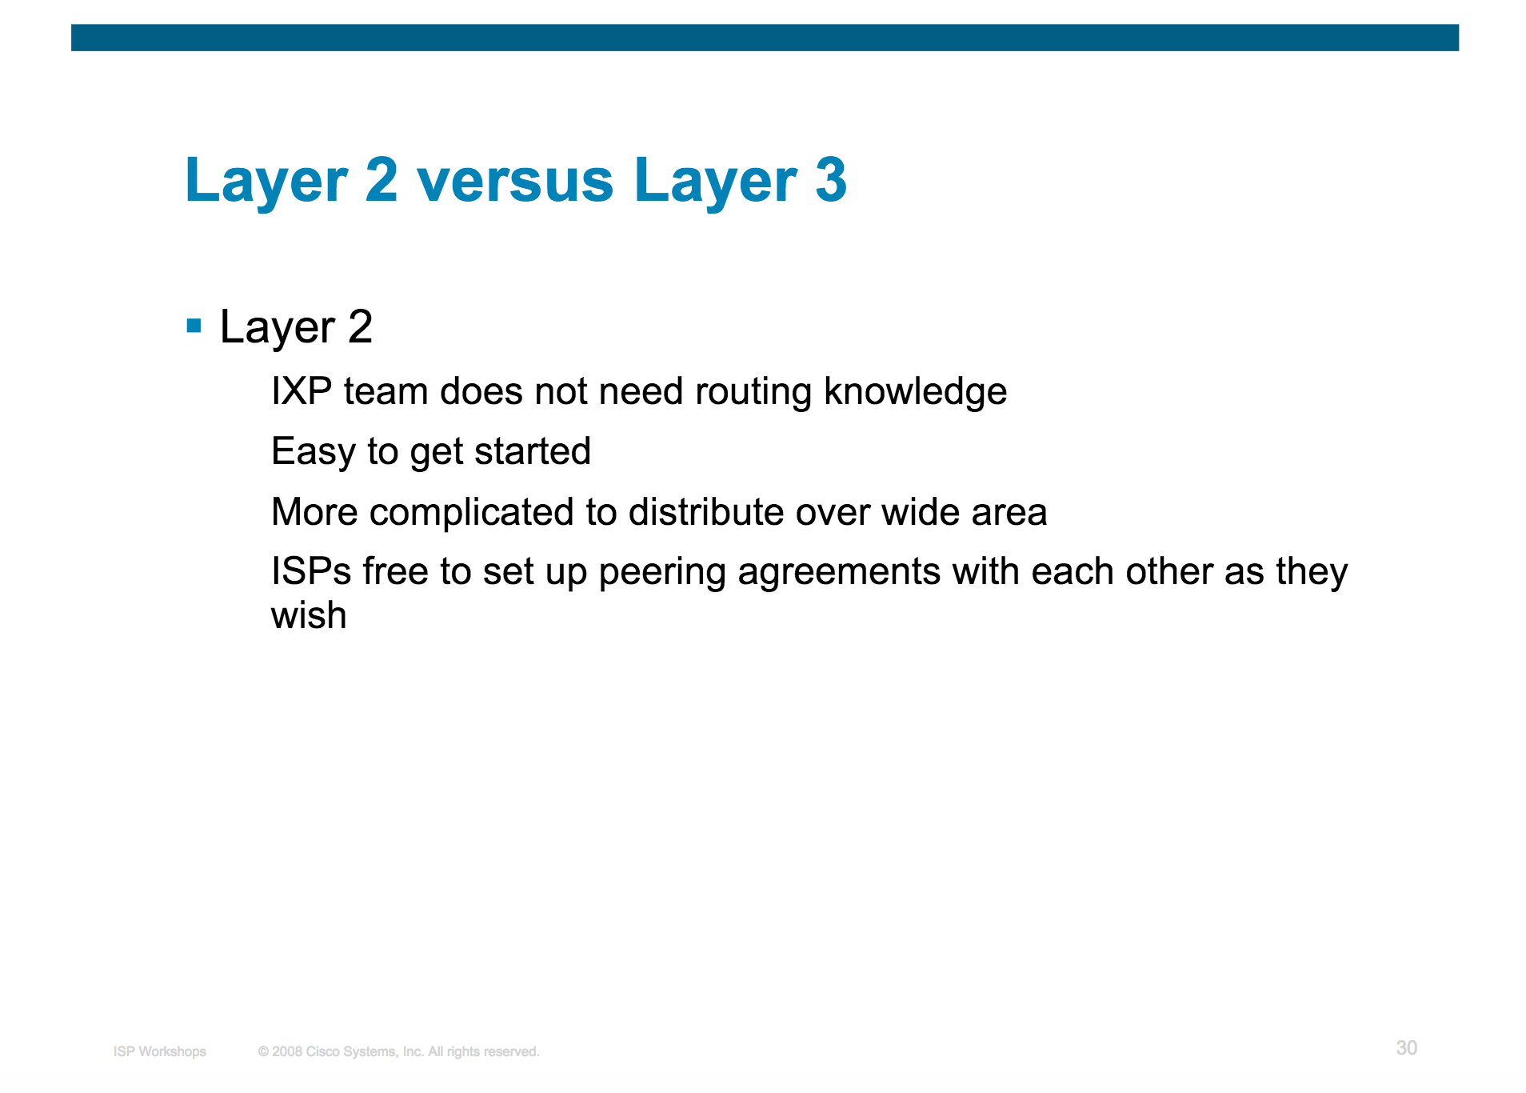
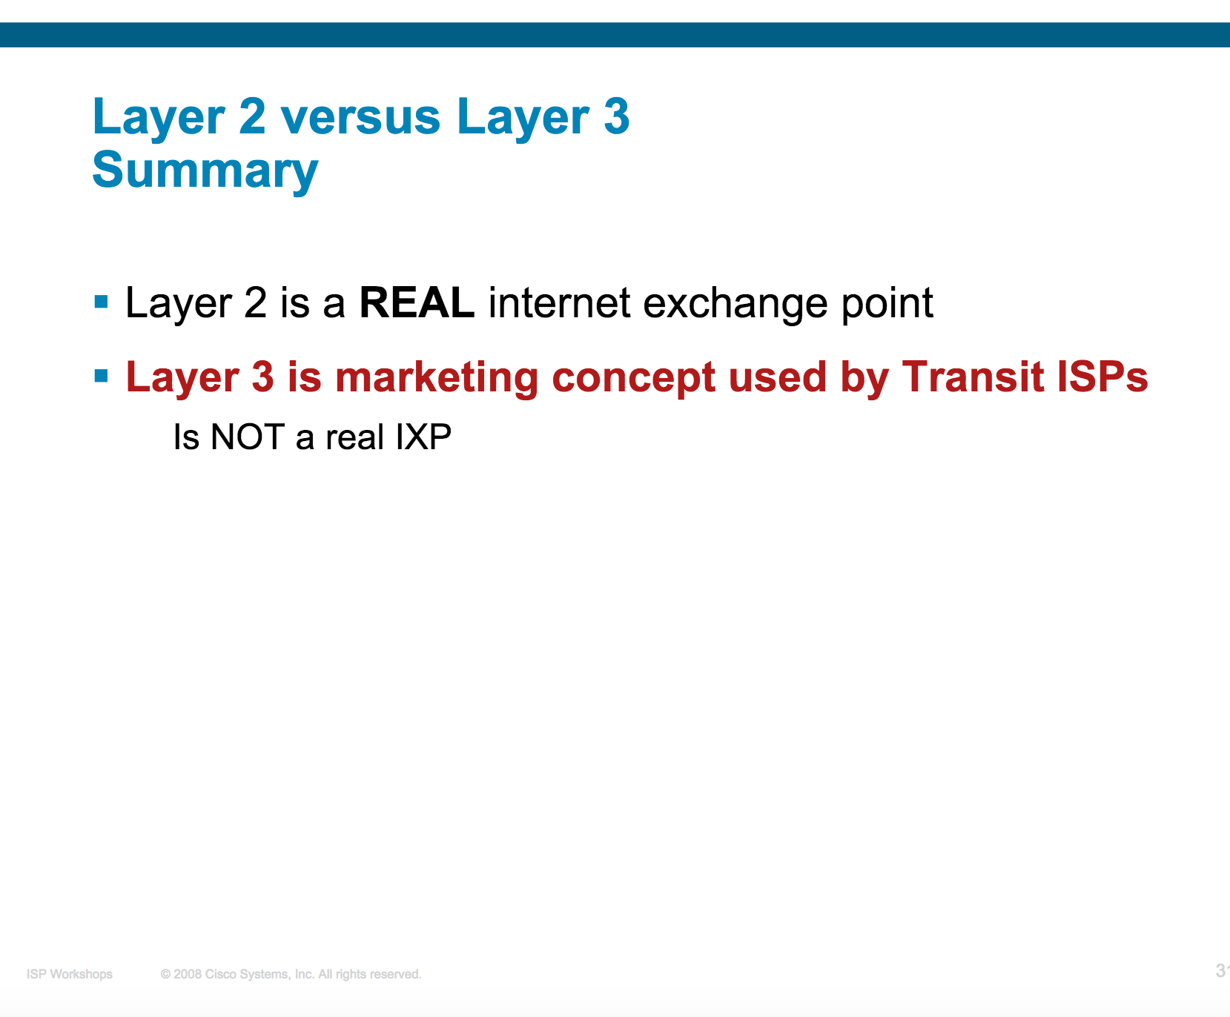
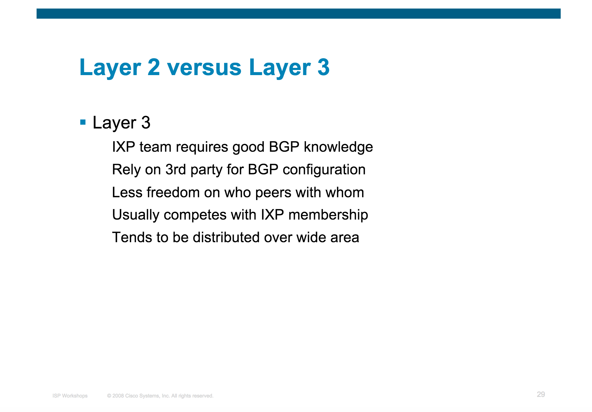

Slide 5
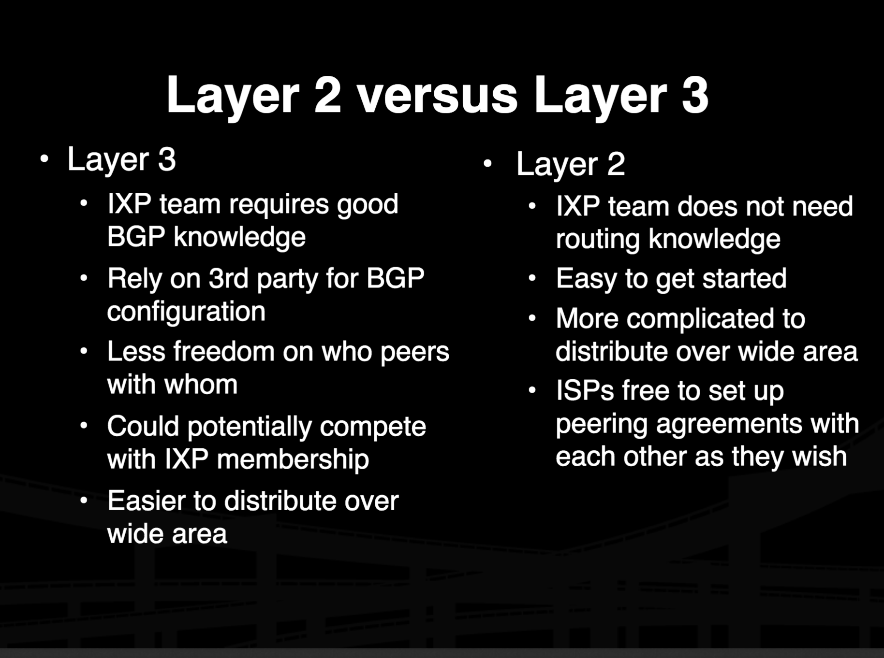

Slide 6
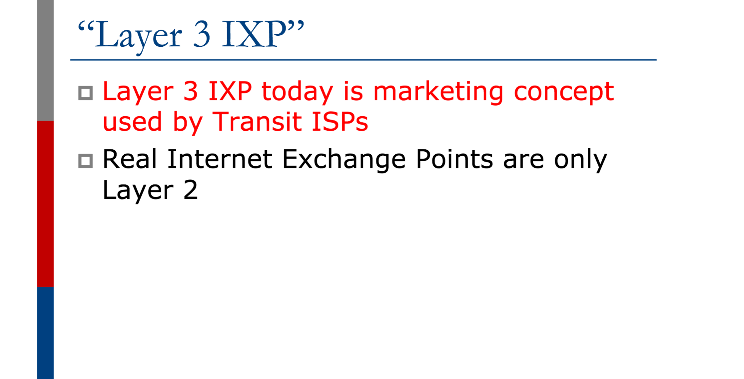

Slide 7
Resistance to Change “Excuses”
If it is not broken… DON’T FIX IT
Our members don’t care
Requires operational downtime
We have all the ISPs connected so we won’t grow

Slide 8
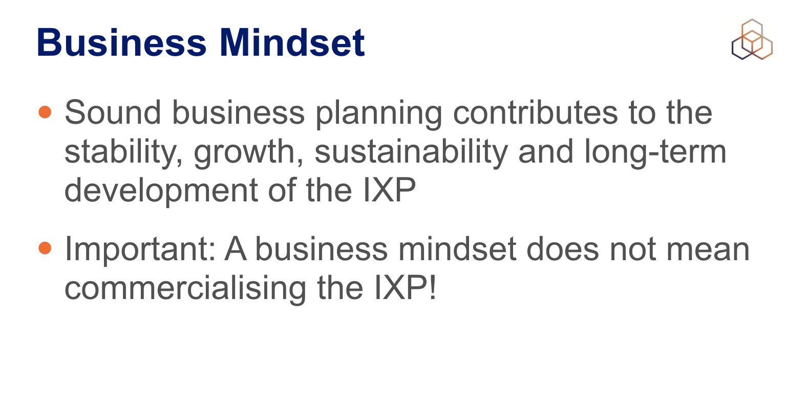

Slide 9
References
https://au.int/sites/default/files/documents/31363-doc-session_9-2-_ixp-network-design.pdf
http://ftp.ipsyn.net/pub/mirrors/cisco/public/cons/isp/ixp/L2_Route_Reflector_IXP_v0.4.pdf
https://www.pacnog.org/pacnog6/IXP/IXP-design.pdf
https://www.sanog.org/resources/sanog7/gaurab-ixp-tutorial.pdf
https://www.menog.org/presentations/menog-13/192-MENOG13-IXP-Design.pdf

